Slide 1
Unit 2 English around the world
Workbook Listening & Speaking

Slide 2
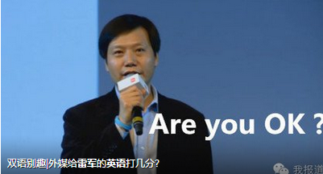
Step 1 Lead-in Is his English good? Whose English is better, yours or his?

Slide 3
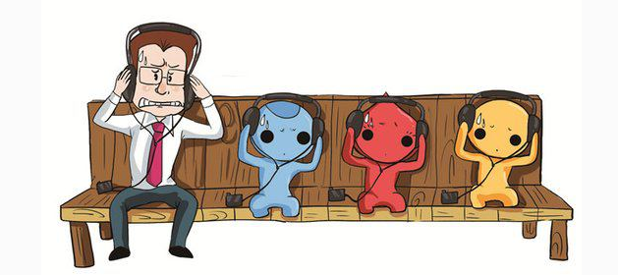
What is the problem?

Slide 4
What do you usually do to improve your English learning? Discuss with your partner.
(pair work)
useful expressions:
read newspapers/novels magazines
watch films
watch TV series
speak to foreigners
listen to English songs
remember words
recite beautiful articles
write from memory
attend speeches

Slide 5
listen to the conversation between Wang Ting and Chen Peng and finish the tasks.
Chen Peng
Wang Ting

Slide 6
Step 2 Pre-Listening (P52)
vocabularies:
Interview 访谈
CCTV 9 中国中央电视台9套
subtitle 字幕
idiomatic English expressions
地道的英语表达
regularly 定期地
native speakers 当地人
.

Slide 7
Step 3 While-Listening
Q&A (三问五答)
Please take notes while listening. After that you are required to finish eight questions related to the material. (ask 3 questions and answer 5 questions). After that you are required to finish the blank.

Slide 8
Step 3 While-Listening
Task 1: Q&A
Ask 3 questions in English:
1.程鹏喜欢看中国中央电视台9套吗？
Ask: Does Chen Peng like to watch CCTV 9 ?
Answer: Yes,he does.

Slide 9
Step 3 While-Listening
2. 程鹏过去经常看英语电影吗？
Ask: Did Chen Peng often watch English films?
Answer: Yes,did.
3. 他现在还经常看吗？
Ask: Does he watch them now?
Answer: He doesn’t watch them now as he thinks they are too hard without Chinese subtitles.

Slide 10
Step 3 While-Listening Answer 5 questions:
4. What is Wang Ting going to do
this weekend?
Answer: Wang Ting is going to buy some
CDs to improve her English.

Slide 11
Step 3 While-Listening
5. What does Wang Ting think about
listening to English songs?
Answer: She likes to listen to English songs
to learn idiomatic English expressions.

Slide 12
Step 3 While-Listening
6. What does Chen Peng like watching on CCTV 9?
Answer: He likes listening to Chinese people and reading the English subtitles.
7. What does Wang Ting ask Chen Peng to do?
Answer: She asks him to listen to native speakers more often.

Slide 13
Step 3 While-Listening
8. Do you think Cheng Peng will listen to the native speakers to improve his listening skills ?
Answer: Yes, I think so.

Slide 14
Step 4 While-Listening Task2 :Fill in the blank
English songs
1. Listening to ____________ is an easy
way to _____ some idiomatic __________.
2. Watching _________________________
___________ is a good way to ________
your _____________ of English.
3. Listening to _________________ can
improve your _____________.
learn
expressions
the news and the interviews on CCTV 9
practise
understanding
the native speakers
listening skills

Slide 15
Listening text (read after the tape)
CP= Chen Peng (male) WT= Wang Ting
C P: What are you doing this weekend, Wang Ting?
WT: I’m going to buy some CDs to improve my English.
C P: What? Are you kidding?

Slide 16
WT: No, I often listen to English songs and learn them. It’s an easy way to learn some idiomatic English expressions. Sometimes I watch films too.
C P: No, not me! I used to watch English films but I can’t understand them without the Chinese subtitles. I think English is too hard.

Slide 17
WT: You give up too easily. Why not watch CCTV 9 or listen to songs like me?
C P: I sometimes do that. I like watching the news and the interviews on CCTV 9. They often have Chinese people talking and they give subtitles in English to explain what they are saying. I find that very useful.

Slide 18
WT: Yes, that’s a good way to practise your understanding of English. Why don’t you also listen to the native speakers and improve your listening skills?

Slide 19
C P: Yes, I think I’ll do that more regularly. My teacher always says that “little and often” is the way to learn. She’ll be proud of me!
WT: I’m sure she will.

Slide 20
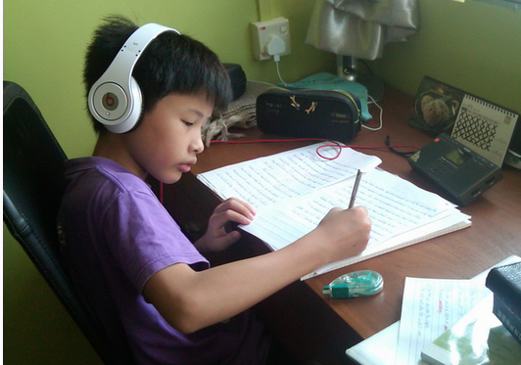
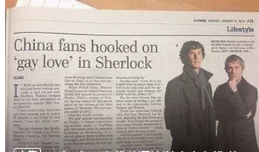
Step 4 Post-Listening
Group Work
1, What methods are mentioned below in learning English?

Slide 21
2.Discuss with your group to know the advantages and disadvantages about methods mentioned above.
useful expressions:
hear native speakers
get used to different accents
improve English
easy to follow
unfamiliar vocabulary
rather fast
difficult
too fast to
useful sentences:
Everything has two sides and ______ is not an exception, it has both advantages and disadvantages.
People’s opinions about ______ vary from person to person. Some people say that ______.To them,_____.

Slide 22
Step 4 Post-Listening
Method | Advantages (merit, strong point) | Disadvantages/shortcoming/weak point)
listen to English programmes on the radio
watch films
read newspapers

Slide 23
Method | Advantages (merit, strong point) | Disadvantages/shortcoming/weak point)
listen to English programmes on the radio | hear native speakers get used to different accents | rather fast
watch films | easy to follow | too fast to understand
read newspapers | helps improve English | unfamiliar vocabulary

Slide 24
Homework
1. Listen to the tape and try to remember the phrases underlined.
2. Master the usage of the useful expressions and sentences of advantage and disadvantage.

Slide 25
Thank you !

