Slide 1
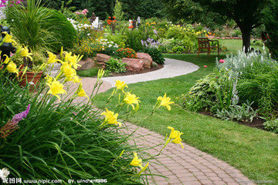
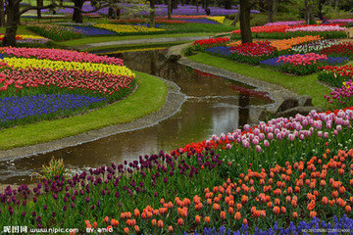
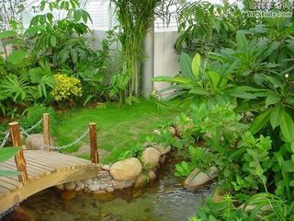
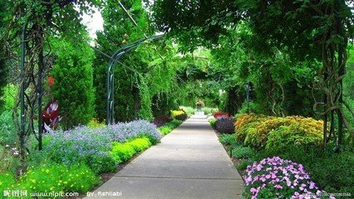

Slide 2
Revise the words:
1.competition [kɔmpi tiʃən] n.
2.neat [ni:t] adj
3.path [pɑ:θ] n.
4.wooden ['wudn] adj.
5.pool [pu:l]
6.enter for

Slide 3
Task 1: Listen and answer
课文提到了多少个花园？谁的花园是最漂亮的？
How many gardens have been mentioned in the text?
Whose garden is the most beautiful?
Three.
Joe’s.

Slide 4
Task 1: Listen and ask your partner the following Qs.
1 Joe Sanders 每年赢得什么比赛？
2 谁的花园更大？
3 为什么Joe's的花园更有趣？
4 谁最努力在花园工作，作者，Bill 还是Joe？
5 作者每年会赢得什么奖？

Slide 5
1 Joe Sanders 每年赢得什么比赛？
What competition does Joe Sanders win each year?
2 谁的花园更大？
Whose garden is larger?
3 为什么Joe’s的花园更有趣？
Why is Joe’s garden more interesting?
4 谁最努力在花园工作，作者，Bill 还是Joe？
Who works the hardest in the garden ,the writer ,Bill or Joe?
5作者每年会赢得什么奖？
What prize does the writer win every year?

Slide 6
1 Joe Sanders 每年赢得什么比赛？
What competition does Joe Sanders win each year?
He wins the Nicest Garden Competition each year.
2 谁的花园更大？
Whose garden is larger?
Bill Frith's.
3 为什么Joe's的花园更有趣？
Why is Joe's garden more interesting?
Because he has made neat paths and has built a wooden bridge over a pool.

Slide 7
4 谁最努力在花园工作，作者，Bill 还是Joe？
Who works the hardest in the garden ,the writer ,Bill or Joe?
Bill.
5作者每年会赢得什么奖？
What prize does the writer win every year?
A little prize for the worst garden.

Slide 8
Practice：
1 Joe Sanders 每年赢得什么比赛？
最佳花园比赛。
2 谁的花园更大？
Bill Frith's.
3 为什么Joe's的花园更有趣？
因为他建了干净的小路，又在水池上做了一座木桥。
4 谁最努力在花园工作，作者，Bill 还是Joe？
Bill.
5作者每年会赢得什么奖？
一个最糟糕的花园小奖。

Slide 9
1 What competition does Joe Sanders win each year?
He wins the Nicest Garden Competition each year.
2 Whose garden is larger?
Bill Frith's.
3 Why is Joe's garden more interesting?
Because he has made neat paths and has built a wooden bridge over a pool.
4 Who works the hardest in the garden ,the writer ,Bill or Joe?
Bill.
5 What prize does the writer win every year?
A little prize for the worst garden.

Slide 10
Retell the story:
1.Joe Sanders -most beatiful-town
2.Nearly everyone -competition-each year-Joe-every time
3.Bill Firth's -larger-Joe's
4.Bill -harder-more-flowers-vegetables-Joe's-interesting
5.neat paths-wooden bridge-pool
6.I-gardens-but not-work
7.Every year-enter-competition too-always-prize-worst garden-town

Slide 11
Joe Sanders has the most beautiful garden in our town. Nearly everybody enters for “The Nicest Garden Competition” each year, but Joe wins every time. Bill Frith's garden is larger than Joe's. Bill works harder than Joe and grows more flowers and vegetables, but Jo’s garden is more interesting. He has made neat paths and has built a wooden bridge over a pool. I like gardens too, but I do not like hard work. Every year I enter for the garden competition too, and I always win a little prize for the worst garden in the town!

