Slide 1
Unit 2 This is my sister.
Grammar Focus

Slide 2
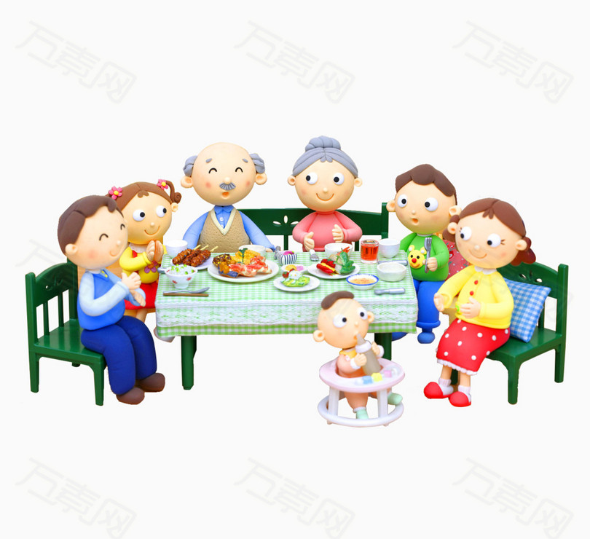
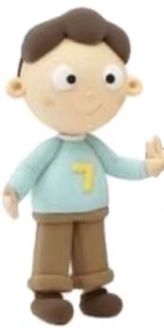
That is my .
grandparents
These are my .
Those are my .
This is my family.
This is my .
brothers
mother
father

Slide 3
When you want to introduce someone, you should use this and that.
that’s
This is my father.
That is my mother.
These are my grandparents.
Those are my brothers.
When you want to introduce some people, you should use these and those.
What do you know from these sentences?
this/these: close
that/those: far

Slide 4
- Jim, is my friend Frank.
- Nice to meet you, Frank.
A. it
B. this
C. these
D. those

Slide 5
is my mother, and is my aunt over there.
A. This; that
B. That; this
C. It; this
D. It; that

Slide 6
- Hello！May I speak to Mary?
- Mary. Who ?
A. This is; are you
B. I am; is that
C. This is; is that
D. I am; are you

Slide 7
Kate, is my mother and are my sisters.
A. this; this
B. this; these
C. she; they
D. this; that

Slide 8
-Are those your photos?
- .
A. Yes, those are.
B. Yes, they are.
C. Yes, we are.
D. No, those aren’t.

Slide 9
She is
She’s my mother.
Who is
Who’s she?

Slide 10
He is
He’s my brother.
Who’s he?

Slide 11
They are
They‘re my grandparents.
Who are
Who’re they?

Slide 12
- Who is that man over there?
- my father.
He’s
A. They’re
B. She’s
In English, we have he, she, it, they to refer to third person.
C. He’s
D. It’s
- Who is it?
- me.
It’s
A. That’s
B. I am
C. It
D. It’s

Slide 13
Complete the conversation and practice it with your partner.
A: That my family. That’s my mother.
B: he?
A: my father.
B: Who’s ?
A: She’s sister.
B: And they?
A: my parents.
is
Who’s
He’s
she
my
who’re
They’re

Slide 14
Look at the pictures.
Make sentences with the words in the three boxes.
this
that
these
those
father
grandfather
parents
brothers
mother
grandmother
grandparents
sister
my
your

Slide 15
Now, take out your family photo and make conversations!

Slide 16
Goodbye!

