Slide 1
英语教学课件
人教课标版
高二必修5 Unit 1

Slide 2
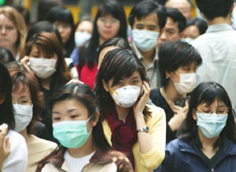
Why are they wearing masks?
What impressed you most in 2020?

Slide 3
The novel coronavirus, a deadly infectious disease hit China.

Slide 4
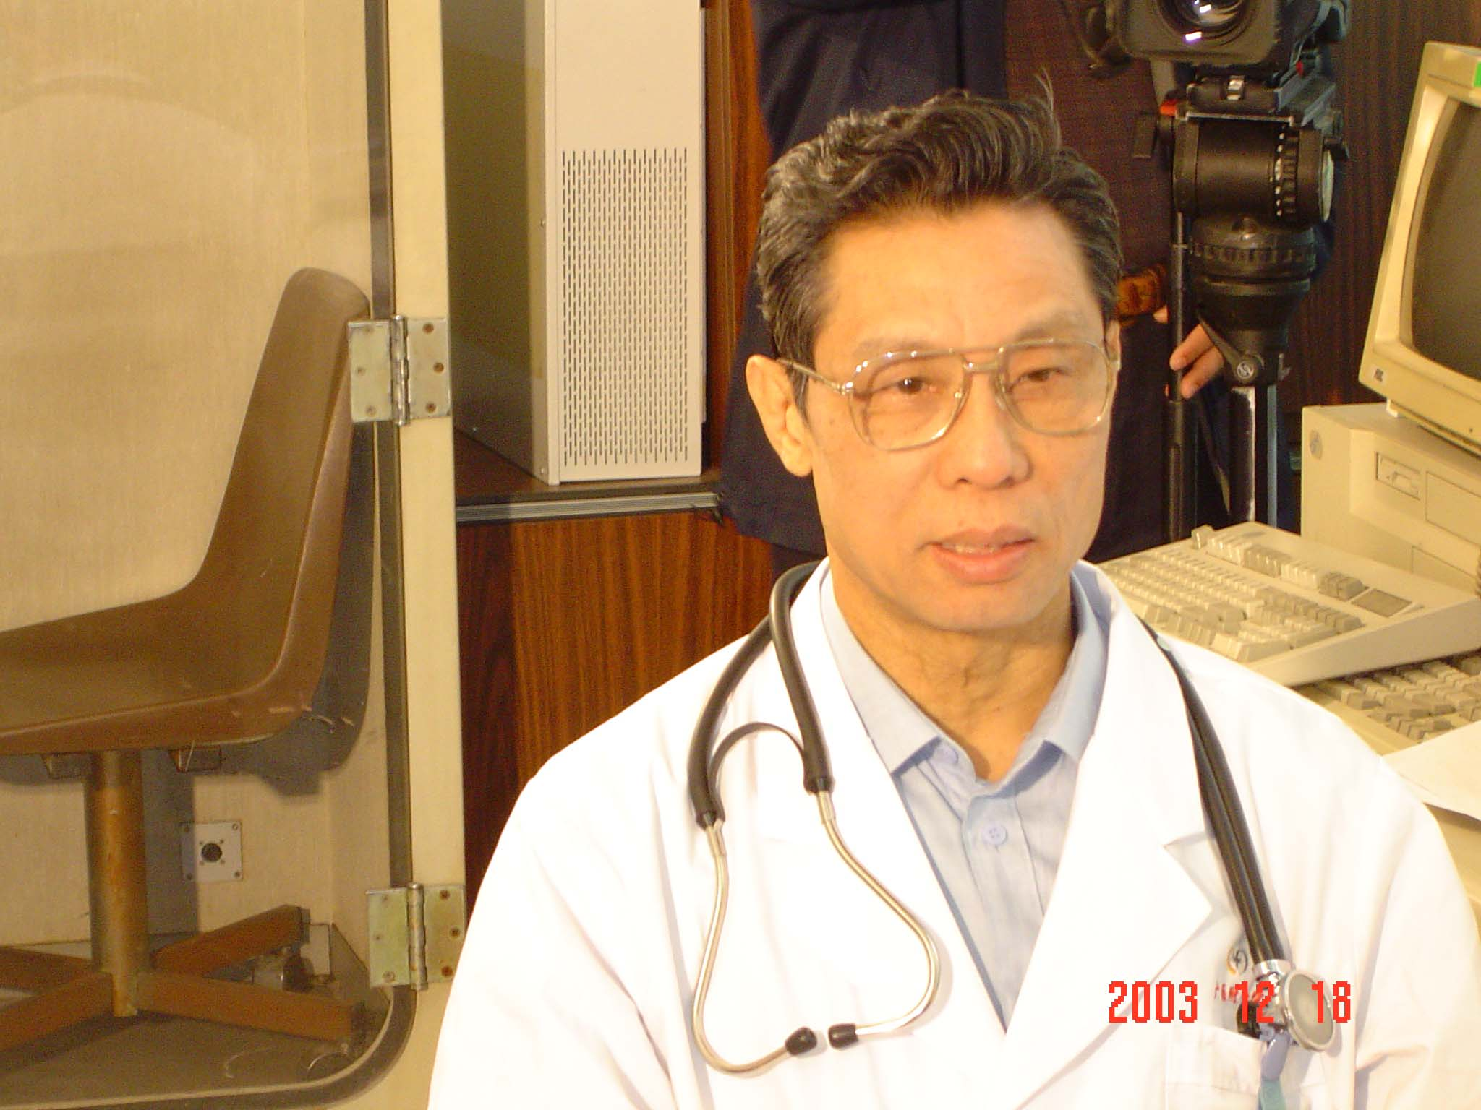
Which person impressed you most during the Spring Festival?
Zhong Nanshan (钟南山)

Slide 5
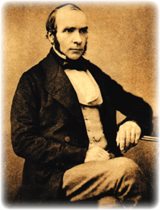
Skimming::
Who was the great scientist in the passage and what was the deadly disease of his day?
John Snow
cholera

Slide 6
What is Cholera?
Cholera is the illness caused by a bacterium called Vibria cholerae. It infects people’s intestines(肠), causing diarrhea(腹泻), vomiting(呕吐) and leg cramps(小腿抽筋).

Slide 7
draw a conclusion
Pre-reading
think of a method
Please put the
7 stages in right order according to the passage.
collect results
make a question
find a problem
analyse the results
Find supporting evidence

Slide 8
The right order:
1.find a problem
2.make a question
3.think of a method
4.collect results
5.analyse the results
6.find supporting evidence
7.draw a conclusion

Slide 9
John Snow Defeats “King Cholera”

Slide 10
Fast reading
1.What is the problem?
2.What’s the cause of cholera?
Make a question: two theories
3.Where did many deaths happen and no death happen from the map?
4.What extra evidence did he find?
5.What conclusion can we draw?

Slide 11
What is the problem?
Cholera was the deadly disease of its day. Neither its cause nor its cure
was understood.
What’s the cause of cholera?

Slide 12
Make a question: two theories
1. Cholera multiplied in the air.
A cloud of dangerous gas floated
around until it found its victims.
2. People absorbed it with their meals.

Slide 13
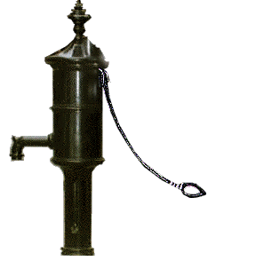
Broad Street
Public house
Many deaths happened here.
No death happened here.
The water from the pump was to blame.

Slide 14
The water was from the river
which had been polluted by
the dirty water from London.
Small, white, flocculent particles

Slide 15
Find supporting evidence: What extra evidence did he find?
A woman and her daughter who lived far away but drank the water also died.
Draw a conclusion with certainty
The polluted water
carried the virus.

Slide 16
Careful reading
I. Read the text carefully and fill in the blanks.
Many people died of cholera.
John Snow tried to find out its _____ and ____
cause
cure
People drank water from the pump in ______ Street.
Most died.
Broad

Slide 17
Families were given free beer in the pub at __________ Street.
People removed the ______ from the water pump.
handle
Cambridge
People had no ________
The disease ___________
deaths
slowed down

Slide 18
_______ water carried the disease.
Polluted
Theory 2 that people ________ the disease with their meals proved right. And theory 1 was wrong.
absorbed
________ the source of all the water supplies.
Examine

Slide 19
II. True (T) or false (F):
1. Cholera would never be controlled even if its cause was found.
2. The disease attacked the body quickly from the stomach and soon the affected person died.
3. John Snow began to collect the information before the disease spread.
F
T
F

Slide 20
III. Choose the best answers.
1. What’s the purpose of the text?
A. To show us how difficult it was to find a cure for cholera.
B. To tell us how John Snow found the cause of cholera and the cure for it.
C. To show us how difficult it was to carry out experiments at that time.
D. To tell us the way cholera spread and how serious it was.

Slide 21
2. What inspired John Snow according to the first paragraph?
Being Queen Victoria’s personal
physician.
B. Finding where cholera happened.
C. Helping ordinary people who suffered
from cholera.

Slide 22
3. Why was cholera called “King Cholera” in the text?
A. Because cholera caused many deaths.
B. Because it got its name from Queen Victoria.
C. Because cholera was the most deadly disease of its day.
D. Because it was defeated with the help of the king.

Slide 23
4. Another title of the text might be ______.
John Snow and cholera
The discovery of cholera
C. John Snow: a great scientist

Slide 24
What should you do if you're travelling to a country that has a cholera outbreak?
Group Discussion
Drink only water that you have boiled
or treated with chlorine or iodine. Other
safe drinks include tea or coffee made
with boiled water and carbonated, bottled
beverages with no ice.

Slide 25
Eat only food that's been thoroughly cooked and is still hot, or fruit that you've peeled yourself.
Avoid undercooked or raw fish and shellfish.

Slide 26
Avoid raw salads and vegetables.
Avoid food and drinks from street vendors.
"Boil it, cook it, peel it, or forget it."
TIPS

Slide 27
Homework:
Read the text and learn the new words by heart
Find more information about cholera and John Snow on the Internet.

Slide 28
Thank you for listening!
enilist

