Slide 1
1.an elephant 一只大象
2.an animal 一只动物
3.a kind of 一种的；某种的
4.all kinds of 各种各样的
5.kind of / a little cute 有点可爱
6.be friendly/kind/nice/good to sb. 对…友好
7.be from=come from 来自…
8.walk on two legs 用两条腿走路
9.sleep all day 睡一整天
10.really scary 真地很吓人

Slide 2
1.an elephant 一只大象
2.an animal 一只动物
3.a kind of 一种的；某种的
4.all kinds of 各种各样的
5.kind of / a little cute 有点可爱
6.be friendly/kind/nice/good to sb. 对…友好
7.be from=come from 来自…
8.walk on two legs 用两条腿走路
9.sleep all day 睡一整天
10.really scary 真地很吓人

Slide 3
11.That’s a good name for her. 对她来说，是个好名字
12. like…a lot = like…very much 很喜欢…
13. be in great danger 处于极大危险之中
14. save animals 救助动物
16. cut down many trees 砍倒很多树
17. cut them down 砍倒它们

Slide 4
11.That’s a good name for her.对她来说，是个好名字
12. like…a lot = like…very much 很喜欢…
13. be in great danger 处于极大危险之中
14. save animals 救助动物
16. cut down many trees 砍倒很多树
17. cut them down 砍倒它们

Slide 5
My favorite animal
I like animals and dogs are my favorite animals.
I have a pet dog (from my parents). His name is Peter. He is really beautiful. He is brown and white with blue eyes. He is kind of shy.
He can walk on two legs. He likes to play balls and he sleeps all day. He also likes taking a walk with me. I think he is my best friend.
Animals are our friends. We must be friendly to them.

Slide 6
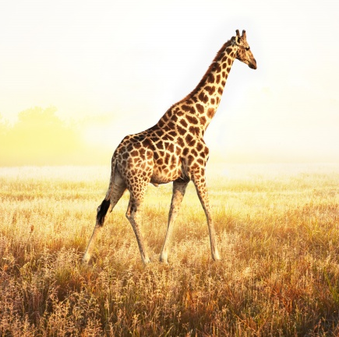
Check the answers.
like beautiful Africa years lives because
This is Becky. Isn’t she _________? She is from _______. She is twelve _____ old. I ____ Becky _______ she is smart and friendly. She _____ in Blackwood Zoo.
beautiful
Africa
years
like
because
lives

Slide 8
标题： My favorite animals
第一段：(开头)
Do you like animals?I like animals . My favorite animals are pandas.
你喜欢动物吗？我喜欢动物，我最喜欢的动物是狗.

Slide 9
产地及居住地
(1)这是贝贝。它是一只大熊猫。它来自中国四川。
This is Beibei. It is a panda. It Sichuan,
China.
(2)它目前在湛江动物园生活 Now it Zhanjiang Zoo
年龄、外貌、
(3)贝贝五岁了。
(4)它黑白相间,并且有一双大眼睛
comes from
lives in

Slide 10
产地及居住地
(1)这是贝贝。它是一只大熊猫。它来自中国四川。
This is Beibei. It is a panda. It Sichuan,
China.
(2)它目前在湛江动物园生活 Now it Zhanjiang Zoo
comes from
lives in

Slide 11
年龄、外貌、
(3)贝贝五岁了。
Beibei is .
(4)它黑白相间,并且有一双大眼睛
Beibei is with two big eyes.
性情
(5)它看起来很漂亮也很可爱,但有时它有点害羞 It and cute.
But sometimes it's .
5 years old
black and white
looks beautiful
kind of shy

Slide 12
习性爱好
(6)它喜欢吃竹子。 It bamboo. (7)它整天都喜欢睡觉 It .
likes eating
likes sleeping all day

Slide 13
第三段：(结尾)
Pandas(Amimals) are our friends.
We must be friendly to them.
大熊猫是我们的朋友. 我们必须对它们友好。
(在介绍某种动物时,应重点写它的产地、外貌、性情、习性等方面。)

Slide 14
My favorite animal
I like animals and dogs are my favorite animals.
I have a pet dog (from my parents). His name is Peter. He is really beautiful. He is brown and white with blue eyes. He is kind of shy.
He can walk on two legs. He likes to play balls and he sleeps all day. He also likes taking a walk with me. I think he is my best friend.
Animals are our friends. We must be friendly to them.

Slide 15
My Favorite Animal
Do you like animals?I like animals . My favorite animals are pandas.
This is Beibei. It is a panda. It comes from Sichuan, China. Now it lives in Zhanjing Zoo. It is five years old. It's black and white with two big eyes. It looks beautiful and cute. But sometimes it's kind of shy. It likes eating bamboo. It likes sleeping all day.
Pandas are our friends. We must be friendly to them.

