Slide 1
Module8 Unit1
Will you help me?

Slide 2
一般将来时：表示将来某一时刻的动作或状态，或将来某一段时间内经常的动作或状态。
表将来时的时间状语：tomorrow（明天）， next week（下周 ）；in the future（将来）
结构形式：（1）be going to do
eg : I am going to play football tomorrow.
（2）will + do
Eg： I will play football tomorrow。

Slide 3
review
What will you do at the weekend?
I will…
go shopping
fly a kite
sing songs
play basketball
play football
watch TV

Slide 4
review
At this weekend:
Are you going to…?
go shopping
fly a kite
sing
play basketball
play football
watch TV

Slide 5
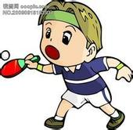
Talk in groups.
PPT模板：www.1ppt.com/moban/ PPT素材：www.1ppt.com/sucai/
PPT背景：www.1ppt.com/beijing/ PPT图表：www.1ppt.com/tubiao/
PPT下载：www.1ppt.com/xiazai/ PPT教程： www.1ppt.com/powerpoint/
资料下载：www.1ppt.com/ziliao/ 范文下载：www.1ppt.com/fanwen/
试卷下载：www.1ppt.com/shiti/ 教案下载：www.1ppt.com/jiaoan/
PPT论坛：www.1ppt.cn PPT课件：www.1ppt.com/kejian/
语文课件：www.1ppt.com/kejian/yuwen/ 数学课件：www.1ppt.com/kejian/shuxue/
英语课件：www.1ppt.com/kejian/yingyu/ 美术课件：www.1ppt.com/kejian/meishu/
科学课件：www.1ppt.com/kejian/kexue/ 物理课件：www.1ppt.com/kejian/wuli/
化学课件：www.1ppt.com/kejian/huaxue/ 生物课件：www.1ppt.com/kejian/shengwu/
地理课件：www.1ppt.com/kejian/dili/ 历史课件：www.1ppt.com/kejian/lishi/
A: Will you …tomorrow ?
B: Yes, I will.
No, I won’t.
Notes:
PPT模板：www.1ppt.com/moban/ PPT素材：www.1ppt.com/sucai/
PPT背景：www.1ppt.com/beijing/ PPT图表：www.1ppt.com/tubiao/
PPT下载：www.1ppt.com/xiazai/ PPT教程： www.1ppt.com/powerpoint/
资料下载：www.1ppt.com/ziliao/ 范文下载：www.1ppt.com/fanwen/
试卷下载：www.1ppt.com/shiti/ 教案下载：www.1ppt.com/jiaoan/
PPT论坛：www.1ppt.cn PPT课件：www.1ppt.com/kejian/
语文课件：www.1ppt.com/kejian/yuwen/ 数学课件：www.1ppt.com/kejian/shuxue/
英语课件：www.1ppt.com/kejian/yingyu/ 美术课件：www.1ppt.com/kejian/meishu/
科学课件：www.1ppt.com/kejian/kexue/ 物理课件：www.1ppt.com/kejian/wuli/
化学课件：www.1ppt.com/kejian/huaxue/ 生物课件：www.1ppt.com/kejian/shengwu/
地理课件：www.1ppt.com/kejian/dili/ 历史课件：www.1ppt.com/kejian/lishi/

Slide 6
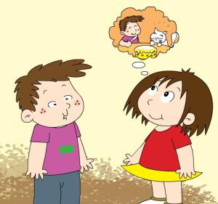
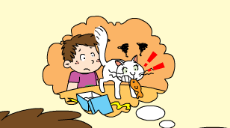
Listen to Part1 and answer.
Whose birthday is tomorrow?
Tomorrow is the cat’s birthday.
What will the boy do?
He will make a paper fish for her.

Slide 7
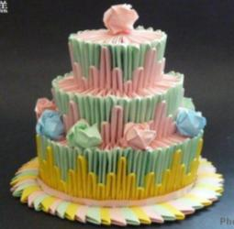
Words.
paper plane
paper
paper flowers
a paper cake
Chinese word
Chinese
dragon

Slide 8
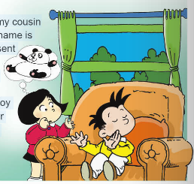
Daming: I’m going to visit my cousin
in New York. His name is
Simon. What present can I
take?
fangfang: What about
a toy panda?
Daming: I think he’s
got a toy panda.
His mother and grandma are Chinese.
…怎么样？
我认为…

Slide 9
Listen and choose .
Daming will go to .
A. London B. New York C. Beijing
2. He will visit his .
A. friend B. cousin C. grandma
3. He wants to take a .
A. present B. panda C. cat

Slide 10
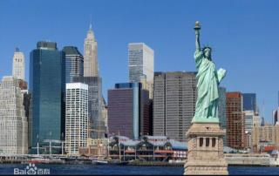
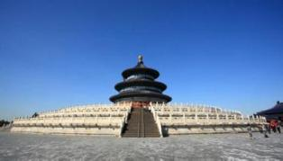
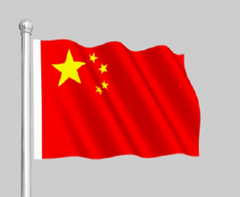
(美国第一大城市)
New York
London
Beijing
the US
the UK
China

Slide 11
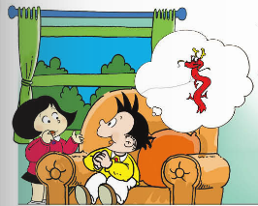
Fangfang: What about a kite?
Daming: Good idea! I’ll make a kite!
Fangfang: But will it be windy in New
York?
Daming: I think so.
有风的
我也这样认为…

Slide 12
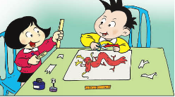
Read and learn
注意要问答呼应噢
Daming: Will you help me?
Fangfang: Of course I will.

Slide 13
Listen and choose .
Daming will make a .
A. bike B. cat C. kite
2. Fangfang_____ help Daming.
A. won’t B. will C. can’t
3. It will_____ in New York.
A. windy B. be windy C. winds

Slide 14
What about…？
……怎么样？
我们可以用它来提出建议噢！
例如：
We’re going to have a picnic. What can I take?
What about some apples?
What about some hamburgers?
What about going shopping?
我们还可以询问看法噢！
例如：
What about the West Lake?

Slide 15
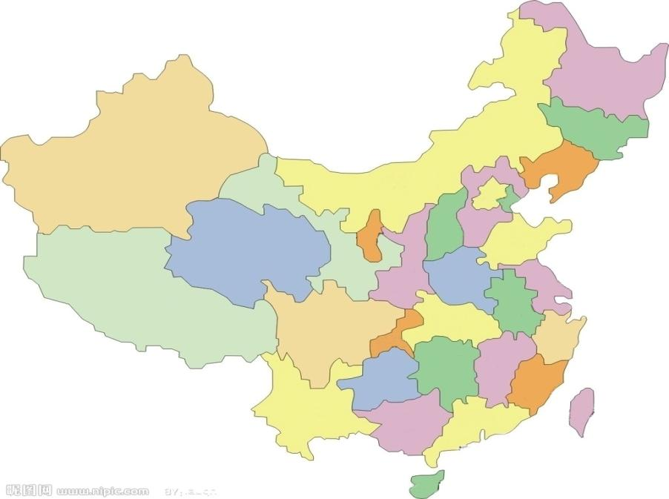
Will it be +天气 in+地点?
Yes, it will./No, it won’t.
Urumqi
Qingdao
Xining
Lhasa
Xi’an
Shanghai
Chengdu
Hangzhou
hot, cold, warm, cool
sunny, rainy, snowy, cloudy, windy

Slide 16
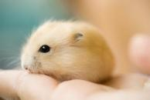
I think…
我认为……
我们可以用它来表达自己的看法噢！
例如：
I think they’re beautiful.
I think it’s lovely.
我们还可以表达自己观点噢！
例如：
I think so.
我也这么认为的/我想是的。
I don’t think so.
我认为不……/我不这样想。

Slide 17
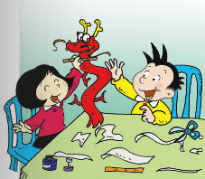
Read and learn
Fangfang: Daming, your cousin will love this
kite. It’s a Chinese dragon.
Daming: Thank you for your help. It will
be a great present.
Fangfang: You can write
the Chinese word for
“dragon” on it.
Daming: That’s a great
idea.
谢谢你…（原因）
汉字“…”

Slide 18
Listen and choose .
Daming’s cousin will____ the kite.
A. cut B. love C. have
2. The kite is a______ .
A. bird B. cat C. dragon
3. They will_____ on it.
A. write Chinese word
B. write numbers
C. draw some flowers

Slide 19
Read and correct
1. Simon is Daming’s friend.
F
cousin
2.Simon’s mother is Chinese.
T
3. Fanfan won't help Daming.
will
F
4. Daming will write the Chinese word for "dragon" on it.
T

Slide 20
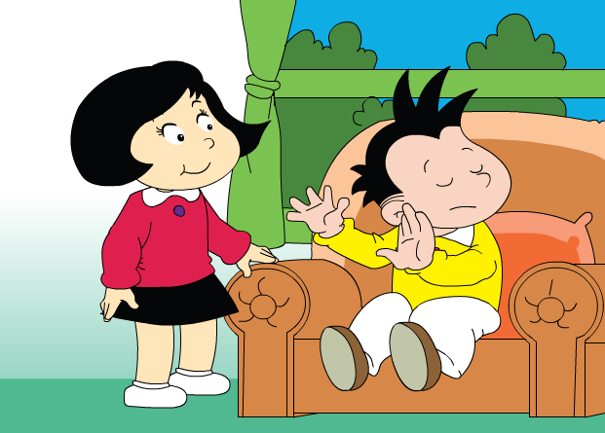
Read and fill in
visit
I’m going to _____ my cousin in ________. His name is . What _______ can I take?
What about __________?
New York
Simon
a toy panda
present
I think a toy panda. His mother and grandma are _________.
he’s got
Chinese

Slide 21
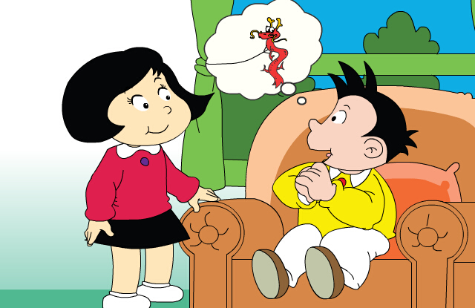
Read and fill in
make a kite
_________! I’ll .
kite
Good idea
What about a ______!
I think .
so
But will it be ______ in New York?
windy

Slide 22
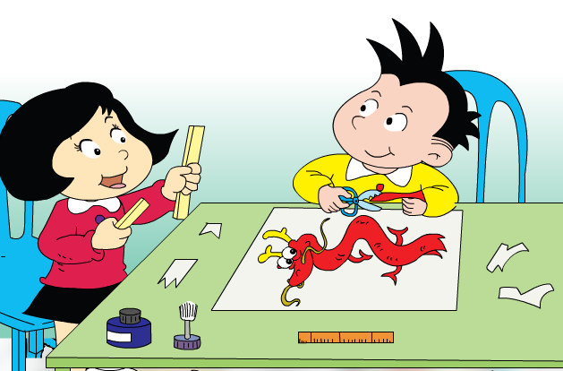
Read and fill in
Will you
help me?
Of course
__________I will.

Slide 23
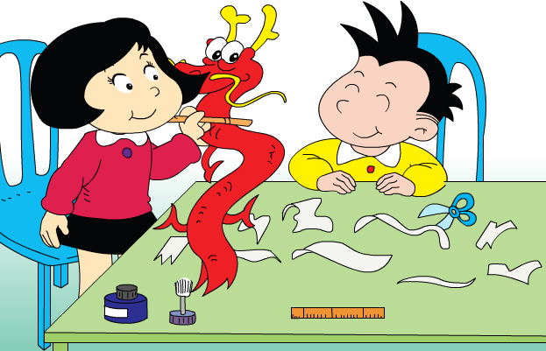
Read and fill in
Daming, your cousin will this kite. It’s _________________.
for
Thank you your help. It _______ a great present.
love
will be
a Chinese dragon
That's a __________.
great idea
You can the Chinese ______ for “dragon"on it
write
word

Slide 24
a toy panda
make a kite
It will be windy
What about
I think
make a paper fish
visit my cousin
in New York
Chinese word
thank you for your help
a great present
That’s a great idea!
I think so
of course
火眼金睛

Slide 25
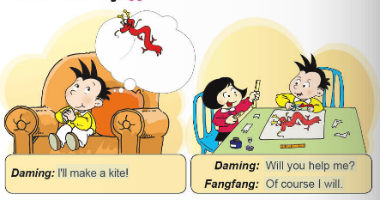
Listen and say

Slide 26
Practise.
A: will you …tomorrow?
B: Yes, I will./No, I won’t.
Of course I will.
wear a coat
play the computer
fly a kite
read a book
have a hamburger
play football

Slide 27
用所给的单词组出单词，并写出中文意思。
arppe
os
paper 纸
so 如此，这样
orwd
gndoar
word词，字
dragon龙
ineeshC
Chinese 中国人的
tnesepr
present 礼物

Slide 28
homewrok
课后作业：
询问你的家人或者朋友，这个周末打算做什么？

