Slide 1
Unit 3 My Weekend Plan
B let’s talk
遂溪县洋青中心小学 陈月娥
ppt.glzy8.com海量PPT模板免费下载
www.xkb1.com

Slide 2
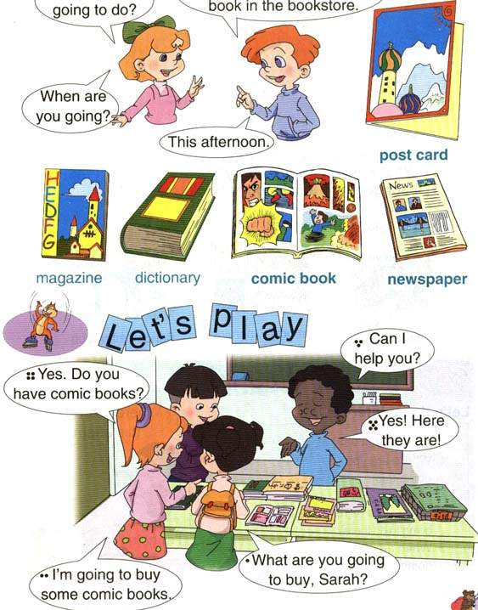


word book

Slide 3
dictionary
comic book
postcard
word book
newspaper
dictionaries
comic books
postcards
word books
newspapers
a一个
an一个
one 一
some一些
any一些
so many很多
two二
a lot很多
Where are you going? To the bookstore.
What are you going to buy?
I am going to buy …….

Slide 4
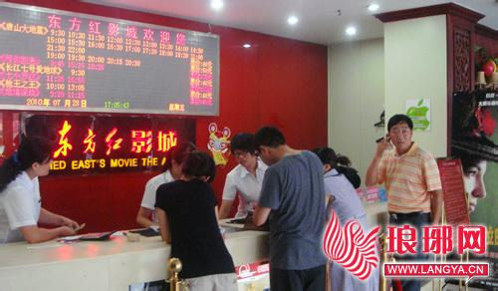
go to the cinema/ see a film

Slide 5
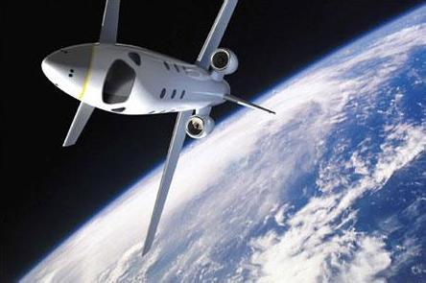
space

Slide 6
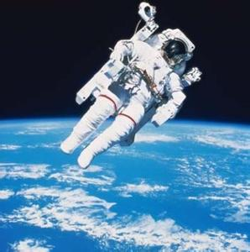
space travel

Slide 7

I have a comic book.
I have so many comic books about space.
lots of

Slide 8


half price
五折
50% off

Slide 9
lots of
space
space travel
half price
on Tuesday
go to the cinema/ see a film

Slide 10
Let’s try
John is on his way home.
He sees Amy.
Listen and answer.

Slide 11
Check your answers
What is Amy going to do?
2.Is the ice cream for John?
She is going to buy some fruit.
No,it’s for his cousin Jack.
www.xkb1.com

Slide 12
Let’s talk

Slide 14
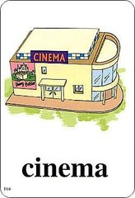

WHY NOT
Why not
为何不…（用来提建议）
Why not go on Tuesday?
Why not go to the cinema?
Why not go swimming?
www.xkb1.com

Slide 15
周二半价？why?
在我国许多电影院周二部分时段或全天电影票价为半价。周二半价的活动始于2005年，为了吸引更多的观众进影院看电影，广州部分影院开始试行半价制度。半价活动一试行就吸引了大量的观众。后来，中国电影放映协会向全国影院发起每周二定位电影票半价日的倡议。不过，周二半价日并不强制执行，影院可以自愿响应，也可以降半价日定在其他日期。在中国，许多影院还是将半价日定在了周二，并一直延续下来。
www.xkb1.com

Slide 16
Fill in the blanks:where what where
Where what how
cinema | See a film | Tuesday
www.xkb1.com

Slide 17

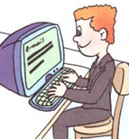

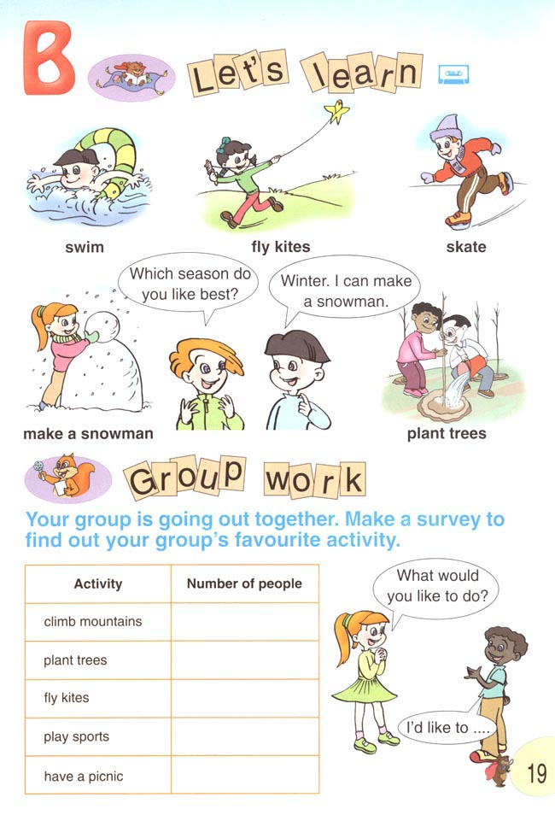


Talk about your and your friends’ weekend plan.

Slide 18
Summary
What have we learned today?
1.Where are you going……
2.What are you going to do?
3.When are you going?
4.Why not……
www.xkb1.com

