Slide 1
八年级（下）英语课件 潮安区登塘中学 郭丽虹

Slide 2
Unit 4 Why don't you talk to your parents?
Section B (1a-1e)

Slide 3
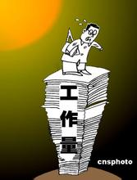
【导】
too much work

Slide 4
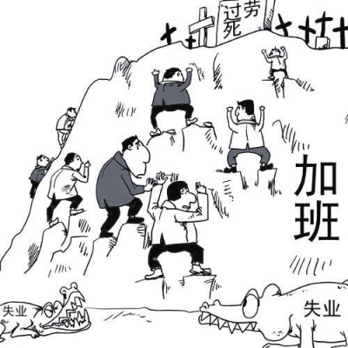
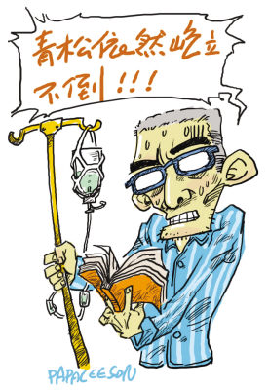
health problems

Slide 5
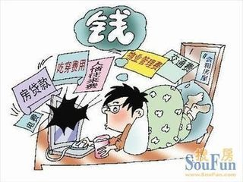
little money

Slide 6
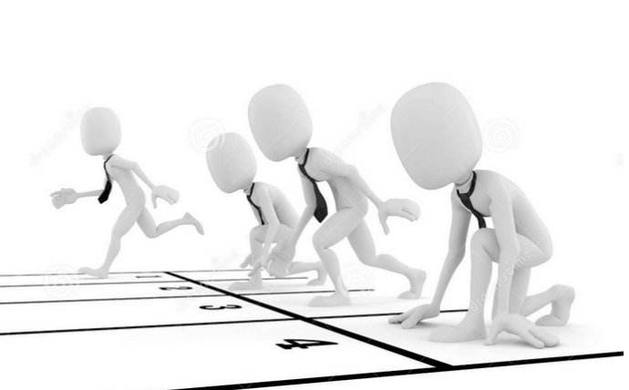
compete with others
与某人
竞争

Slide 7
pressure n.

Slide 8
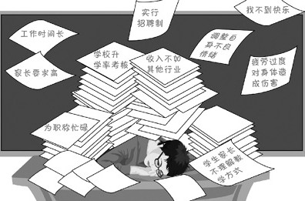
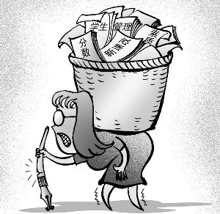
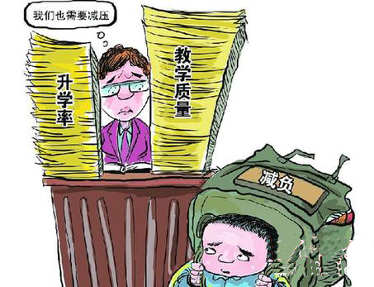
pressure n.
=stress n.
压力
under pressure
在压力下

Slide 9
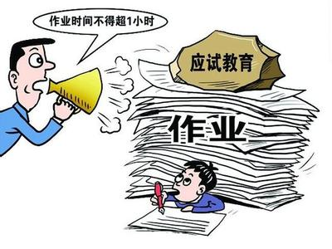
Are you often under pressure (在压力下)?
What activities can you do to lower ( 降低 )your stress?

Slide 10
A: What do we do to lower pressure?
play sports
If you have pressure, why not play sports?

Slide 11
A: What do we do to lower pressure?
hang out with friends
If you are under pressure, you should hang out with friends.

Slide 12
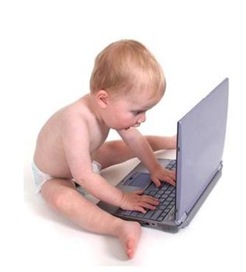
A: What do we do to lower pressure?
play computer games
If you are under pressure, why don’t you play computer games?

Slide 13
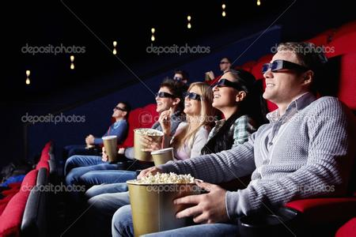
A: What do we do to lower pressure?
If you are under pressure, why not watch movies?
watch movies

Slide 14
A: What do we do to lower pressure?
read books
If you have pressure, you should read books.

Slide 15
A: What do we do to lower pressure?
go shopping
If you have pressure, why don’t you go shopping?

Slide 16
A: What do we do to lower pressure?
If you have pressure, why not talk to family members.
talk to family members

Slide 17
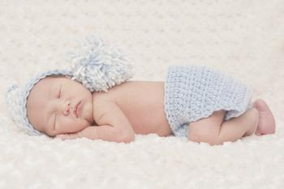
A: What do we do to lower pressure?
sleep
If you have pressure, why not sleep?

Slide 18
【思】
Group-work
What activities can you do to lower your stress? 你可以做什么活动来减压？
1a
_____ read books
_____ talk to parents or other family members
_____ _______________________________
_____ _______________________________
_____ _______________________________
_____ _______________________________
_____ _______________________________
_____ _______________________________

Slide 19
What activities do you like to do to help
lower your stress? 你喜欢做什么活动来减压？
1a
______ read books
______ talk to parents or other family members
______ hang out with friends
______ spend time alone
______ play computer games
______ play sports
______ watch movies
______ listen to music
5
7
8
6
4
1
3
2
the most favorite activity
8 the least favorite activity

Slide 20
Pair-work
1b
Talk about the activities you like best and tell the reasons.两人一组谈论你最喜欢的活动，并给出理由。
A:I always_________ to lower stress.
Because_______________________
What about you ?
B:I ’d like to ___. Because___
read books
hang out with friends
spend time alone
play computer games
…
I think it’s the most
interesting activity.
…
I think it can make me relaxed.
play sports

Slide 21
Before listening(听力前的准备)
【议】
朗读并翻译1c的句子。
1.My parents give me a lot of pressure about school.
2.I don’t get enough sleep.
3.I don’t have enough free time.
4.I had a fight with my parents.
5.I have to compete with my classmates at school.
父母给了我很多学习压力。
我没有足够的睡眠。
我没有足够的自由时间。
我和父母吵架了。
我在学校必须和同学们竞争。

Slide 22
Listening
1c
Listen and check the problems Wei Ming talks about.
___ 1.My parents give me a lot of pressure
about school.
___ 2.I don’t get enough sleep.
___ 3.I don’t have enough free time.
___ 4.I had a fight with my parents.
___ 5.I have to compete with my classmates
at school.

Slide 23
Listen again. What advice does Alice give to Wei Ming? Choose the right numbers and fill in the blanks.
1d
1.helping 2.sports 3.unhappy
4.grades 5.pressure 6.compete
unhappy
1. Although you may be ________ with your parents, you should talk to them. Ask them why they give you so much _______.
2. Life shouldn’t just be about ______. Free time activities like _____ and hanging out with friends are important, too.
3. You shouldn’t _______ with your classmates to get better grades. You should all be _______ each other to improve.
pressure
grades
sports
compete
helping

Slide 24
Talk about your problems and give your advice.(谈论你的烦恼并给出建议)
Pair-work
【展】
A:What's wrong with you?
B: _______________________What should I do?
A:________________________________________
B:Thanks.What do you usually do to lower stress?
A:I usually ____________ .What about you?
B: I’d like to ____________.
1.My parents give me a lot of pressure about school. | 1.You could talk to your parents about it. | spend time alone watch movies listen to music play computer games …
2.I don’t get enough sleep. | 2.You should go to bed early.
3.I’m afraid of speaking in front of people. | 3.You should be more confident.
4.I had a fight with my best friend. | 4.Why don’t you call him/her up to say sorry.
… | …
play sports
read books
I have too much homework.
I think you could talk to your teacher about it.

Slide 25
1. spend time alone
【评】
“花费”
㈠spend some time or money on sth./(in) doing sth.
㈡it takes sb. some time to do sth.
㈢sb. pay some money for sth.
㈣sth. cost sb. some time/money
1.I have to ______them 20 pounds for this room each month.
A. pay B. paid C. cost D. took
2. They spend too much time ______the report .
A. writing B. to write C. on writing D. write
A
A

Slide 26
3. What beautiful shoes you’re wearing! They must be expensive .
--No，they only——l0 yuan．
A．spent B．took C．paid D．cost
4. It will _____ me too much time to read this book.
A. take B. cost C. spend D.pay
D
A

Slide 27
2. I have to compete with my classmates at school.
compete v.竞争，对抗；n. competition,竞争，比赛，n. competitor竞争者；对手
compete with sb.与某人竞争
翻译：你必须和其他所有人竞争。
You have to _______ ________ everybody else.
compete with

Slide 28
检
Ⅰ. 用所给词的适当形式填空
1. My parents give me a lot of_______ (press).
2. There are many after-school_________ (activity) now.
3. We should study hard_______ (get) better grades.
4. _______(hang) out with your friends is a good way to reduce your sadness.
5. Don’t be _______(worry) about that. I can do it by myself.
pressure
activities
to get
Hanging
worried

Slide 29
Ⅱ. 单项选择
1. Giving stress is not good for children.
so much B. so many
C. too many D. many so
2. I don’t want to compete anyone. I only want to do my work well.
to B. in
C. on D. with

Slide 30
3. you are angry, you shouldn’t have a fight with him.
A. Although; but B. But; although
C. Although; / D. But; /

Slide 31
Homework
Read the passage in your learning paper and find out more ways to lower your stress.

