Slide 1

Unit 6
I’m going to study computer science.
Section A
Period 1

Slide 2
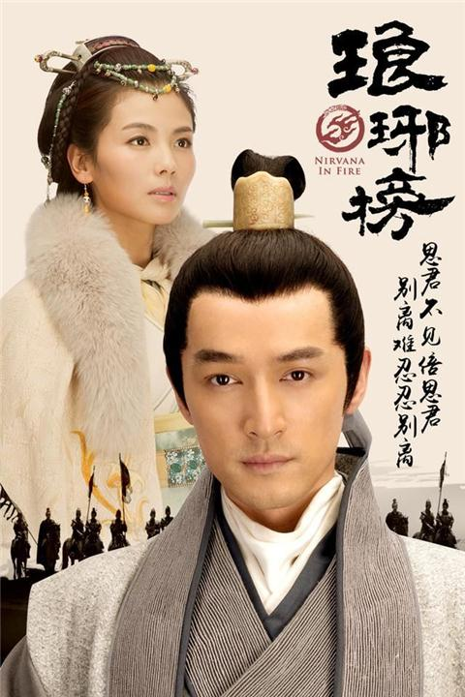
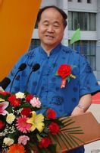
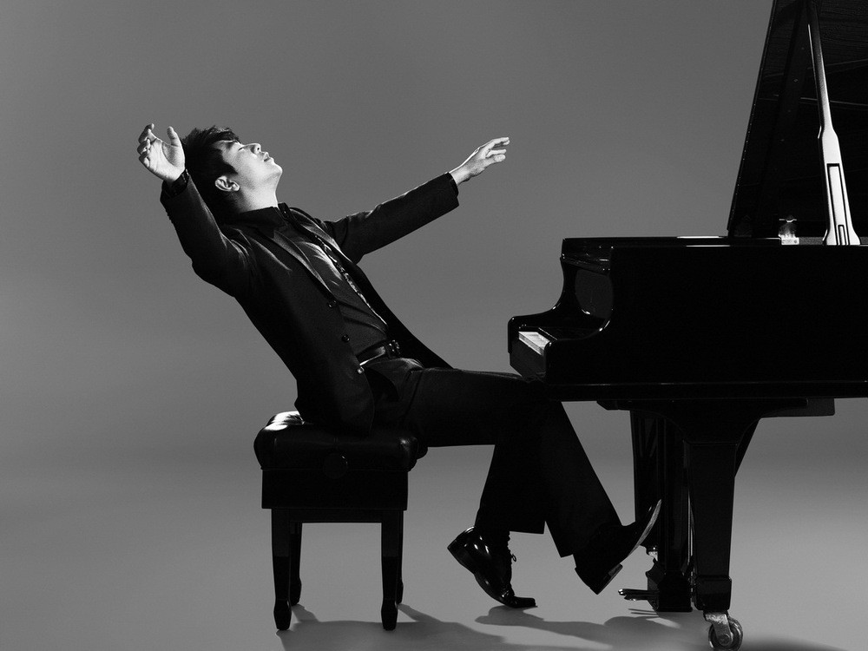



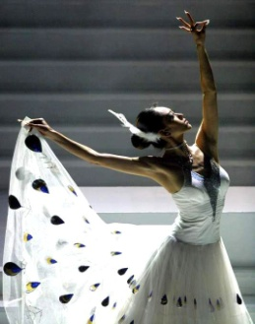



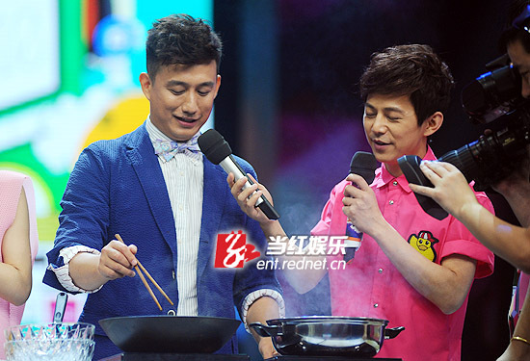


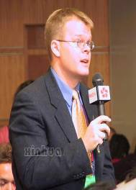


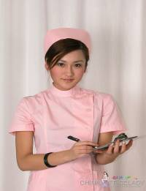
莫言
writer
pianist
actor
actress
dancer
dream jobs
reporter
cook
nurse
doctor

Slide 3
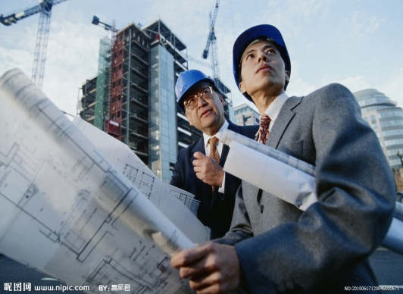
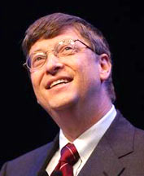
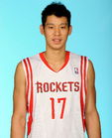
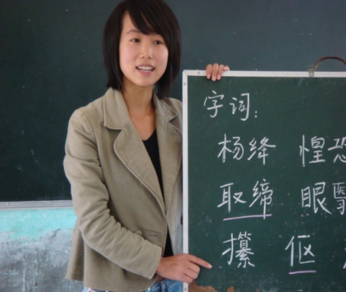
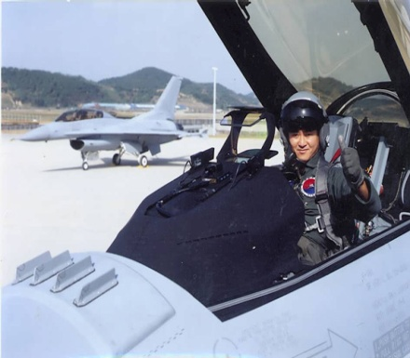
Pairwork
Bill Gates
a computer programmer
an engineer
A: What are you going to be when you
grow up?
B: I’m going to be ….
a professional
basketball player
a teacher
a pilot

Slide 4

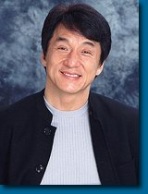
I’m going to be an actor when I grow up.

Slide 5

Sentences study
1、A: What are you going to be when you grow up?
B: I’m going to be an actor when I grow up.
be在此意思是“成为，当”,
相当于become。
grow up: “长大（成人）”此处用在when
引导的时间状语从句中，而主句
是一般将来时，所以grow up用
一般现在时表示将来意义。

Slide 6

定义：
表示将要发生的动作，含有“打算”的意思。
标志：
tomorrow , next week/Sunday/month/year ,
this afternoon/ evening…
结构：
主语 + be going to + 动词的原形
例句：
They are going to help the poor .

Slide 7
肯定句句型:主语+be going to+动词原形+……
I am going to play basketball next Sunday.
He is going to live in Japan next year.
We’re going to meet tomorrow.
否定句句型:主语+be not going to +动词原形+……
I’m not going to visit my grandmother tomorrow.
She’s not going to watch TV this afternoon.
Lin Chuangxin is not going to be a dentist.

Slide 8
Exercises
一、用所给词的适当形式填空。
1.The boys __________ (go) play soccer this afternoon.
2. _____ you _____________(play) basketball with me
next week?
3.The actor ___ going to ________(move) New York.
4. He admires actors very much. He’s going to take
_____ (act) lessons every day.
5. Lucy ________________(not stay) at home next
weekend.
are going to
Are
going to play
is
move to
acting
is not going to stay

Slide 9
1b.Listen to the tape ,and write down the answer on the paper.
1、 ____ wants to be a computer programmer.
2、Tina is going to study ____ ____ .
3、Larry wants to be a ____ player.
4、Girls are going to study ____ really hard.
5、Boy wants to be an ____ because I want to be a job that’s fun.
Tina
computer
science
basketball
math
actor

Slide 10


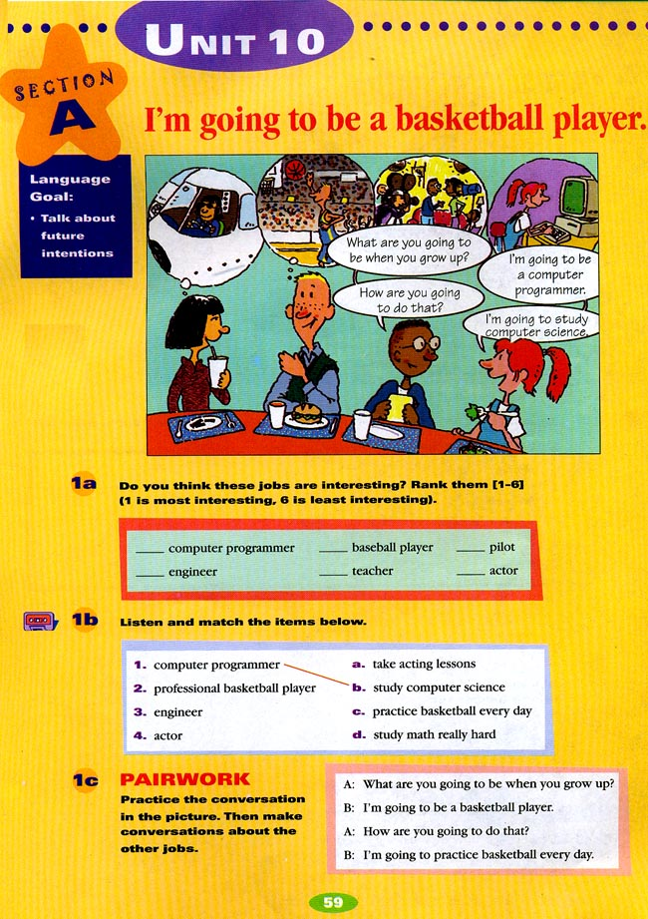
1b listen and match the items below.
Mary
Jack
Tina
Larry
1. computer
programmer
2.basketball player
3. engineer
4. actor
a.take acting lessons
b. study computer
science
c. practice basketball
every day
d. study math really hard

Slide 11
Conversation 1 Boy: Tina, _____ do you want to be when you grow up?
Tina: Hmmm, I think I want to be a ______.
Boy: Wow! Sounds difficult. ___are you going to do that?
Tina: I am going to___________________.
what
computer programmer
How
study computer science
Conversation 2 Girl: Larry, what do you ____ ____ ____ when you grow up?
Larry: I love basketball. So I want to be a basketball player .
Girl: How ____ you _____ _____ do that? Larry: I _____ ____ ____ practice basketball everyday.
want to be
are
going to
am going to

Slide 12
Conversation 3 Boy: What do you want to be _____ you _____?
Girl: I want to ___ an engineer.
Boy: How are you going to ____ that? B: I’m going to ______ math really hard .
when
grow up
be
do
study
Conversation 4
Tina: ____________________ when you grow up?
Boy: __________________because I want a job that’s fun.
Tina: Cool!_________________________? Boy: _______________ take acting lessons.
What do you want to be
I want to be an actor
How are you going to do that
I am going to

Slide 13
1、明天我不打算去买些东西。
I am not going to buy something tomorrow .
2、他将要死了。
He is going to die.
3、她长大后打算做什么？
what is she going to be when she grows up ？
4、我们打算这学期努力学习。
We are going to work/study hard this term.
5、下周我们学校将有一场足球比赛。
There is going to be a football match next week
in our school.

Slide 14
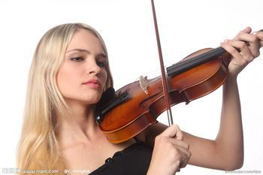
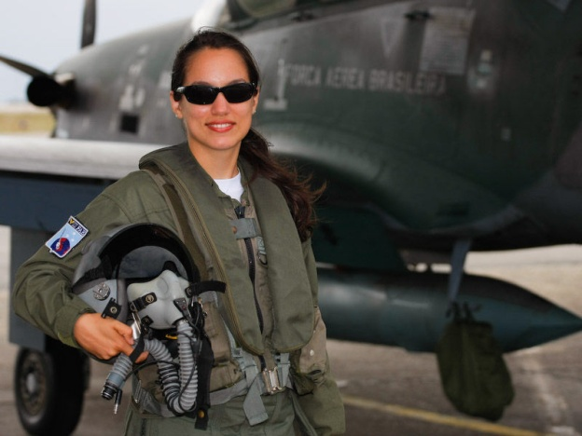
Do you know other jobs?
Bill Gates
an engineer
a computer programmer
/`prəʊgræmə(r)/
a pilot
a violinist
/`pailət/
[ˌvaɪəˈlɪnɪst]

Slide 15

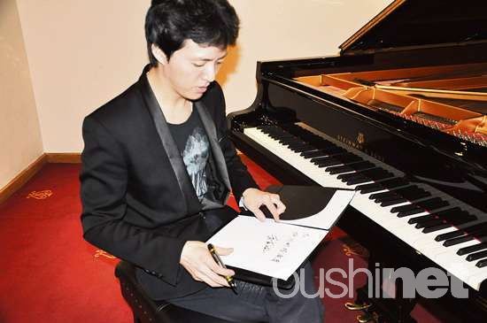

Memory challenge
(根据记忆，说出职业)
莫言

Slide 16
?
How do you make your dream come true
Actions speak louder than words.
?
How are you going to do that

Slide 17

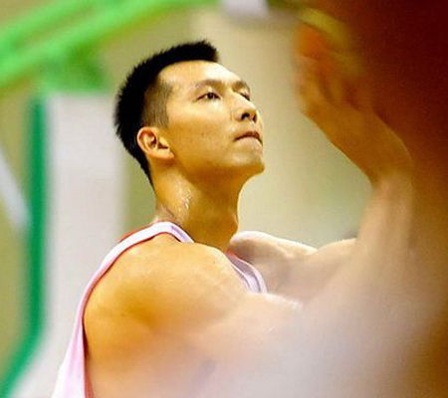
-How are you going to do that？
-I’m going to__________________________.
practice (playing )basketball
every day
A: What are you going to be when you grow up?
B: I’m going to be a professional basketball player.

Slide 18

-How are you going to do that？
-I’m going to______________________.
keep on studying computer science
A: What are you going to be when you grow up?
B: I’m going to be a computer programmer.

Slide 19
-How are you going to do that?
-I’m going to____________________.
take acting lessons
A: What are you going to be when you grow up?
B: I’m going to be an actor.

Slide 20
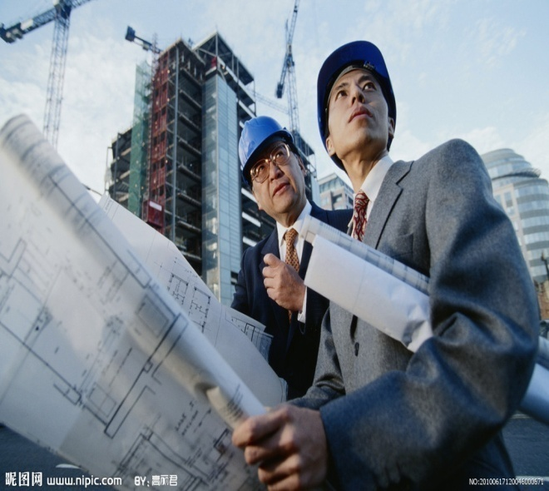
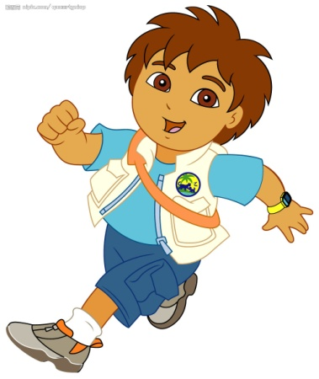
How
going to
-_____ are you ___________ do that?
-I’m going to_____________________.
study math really hard
A: What are you going to be when you grow up?
B: I’m going to be an engineer.

Slide 21

A:--What are you going to be
when you grow up?
B:--I’m going to be a/an…
A:-How are you going to do that?
B:--I’m going to…
take acting(表演) lessons study computer science practice basketball every day study math really hard exercise every day study hard practice singing every day
actor / actress / doctor/ nurse / singer / teacher / reporter / policeman / policewoman / pilot / engineer/ writer / computer programmer / basketball player…
...

Slide 22
I believe I can fly
I believe I can fly
I believe I can touch the sky
I think about it every night and day
Spread my wings and fly away
I believe I can soar
I see me running through that open door
I believe I can fly
I believe I can fly
I believe I can fly

Slide 23
1. Wang Na is going to be an actress when she grows up. (提问)
________ ________Wang Na _________ ___________ ______when she grow up?
2. I’m going to be an engineer when I grow up. (一般疑问句)
________ you _______ _______ ______an engineer when you grow up?
What is going to be
Are going to be

Slide 24
3 、Mr. Sun is going to visit his parents
next month.
(对划线部分提问)
_________ _________ Mr. Sun ________ _________ ______ next month?
4、 Sally is good at studying computer
science.(改为同义句)
Sally ________ ________ ________ studying computer science.
What is going to do
does well in

Slide 25

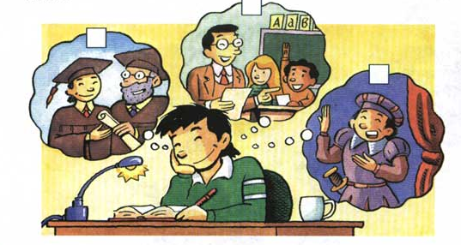
2a
What is Cheng Han going to be?
and What is he going to do?
Check the correct boxes.
⑵
⑴
√
⑶
⑴
Chenghan

Slide 26
2b What are Cheng Han’s plans for the future?
What | He is going to be a .
Where | He is going to move to __________.
How | He ________ learn ____________.
When | He is going to ________________ .
teacher
Shanghai
is going to
how to teach children
finish high school
and college first.

Slide 27
Tapescript
Girl: What do you want to be when you grow up, Cheng Han?
Cheng Han: I’m going to be a teacher.
Girl: Are you going to move to Beijing?
Cheng Han: No, I’m going to move to Shanghai.
Girl: And how are you going to become a teacher?
Cheng Han: Well, I’m going to learn how to teacher children.
Girl: When are you going to start?
Cheng Han: I’m going to finish high school and college first.

Slide 28
2c Ask and answer questions
A: What is Cheng Han going to be?
B: He is going to be a teacher.
A : Where is Cheng Han going to move?
B: He is going to move to Beijing.
A: What is Cheng Han going to do?
B: He is going to learn how to teach children.
A: When is Cheng Han going to start?
B: He is going to finish high school and
college first.

Slide 29
2d Role-play the conversation.
Andy: What are you reading, Ken?
Ken: The Old Man and the Sea by Hemingway.
Andy: Wow, now I know why you’re so good at writing stories.
Ken: Yes, I want to be a writer.
Andy: Really? How are you going to become a writer?
Ken: Well, I’m going to keep on writing stories, of course. What do you want to be?
be good at…
擅长于干…
keep on doing…
继续，坚持干…

Slide 30
1、表示动作的执行者,意为“被;由”
这本书是鲁迅写的。
The book was written by Lu Xun.
2、 now I know why you’re so good at writing stories.
宾语从句要用陈述语序。
宾语从句的结构：连接词+主语+谓语+其他
我不知道他是谁。
I don’t know who he is .
be good at +n/doing sth. “善于”
我擅长唱歌。
I am good at singing.

Slide 31
3、 I’m going to keep on writing stories
keep on doing sth 继续做某事
虽然他累了，但是他继续工作。
Although he is tried , he kept on working.

Slide 32
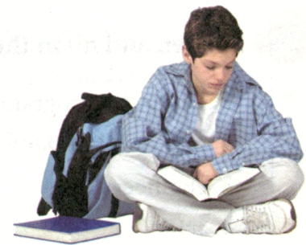
be sure about…
对…有把握，确信…
Andy: My parents want me to be a doctor, but I’m not sure about that.
Ken: Well, don’t worry. Not everyone knows what they want to be. Just make sure you try your best. Then you can be anything you want!
Andy: Yes, you’re right.
try one’s best
尽最大努力
make sure
确信，证实

Slide 33
4、but I’m not sure about that.
be sure about 对……有把握
我对答案没有把握。
I’ m not sure about the answer.
5、Just make sure you try your best
确保一切都好。
Make sure everything is OK.
make sure to do sth.确保去做某事
明天确保准时到校。
Make sure to go to school on time tomorrow.

Slide 34
知识巩固
1 What is Nancy going to be when she________?
---Maybe she is going to be a math teacher.
A. grow B. grows C. grow up D. grows up
2、You need to take notes at the meeting, so make sure
_______ a pen and some paper with you.
A. bring B. bringing C. to bring D. not bring
3、---How are you going to become a write?
---I’m going to keep on _______stories.
A. write B. writing C. to write D. to writing

Slide 35
4、There _______ an art exhibition this Sunday.
A. have B. is going to be
C. is going to have D. is going to hold
5、---There is a new movie Let Bullets Fly.
Let’s watch it.
---That _______ a good movie.
A. sounds B. sounds like C. looks D. looks like
6、---_________ are you going to work?
---I’m not sure yet. Maybe Beijing or Shanghai.
A. When B. Why C. How D. Where

Slide 36











SUMMARY :
What did we learn today?
a computer
programmer
study computer science
What are you going to be
when you grow up?
an engineer
study math really hard
How are you
going to do that?
a pilot
take acting lessons
practice basketball every day
a professional
basketball player

Slide 37

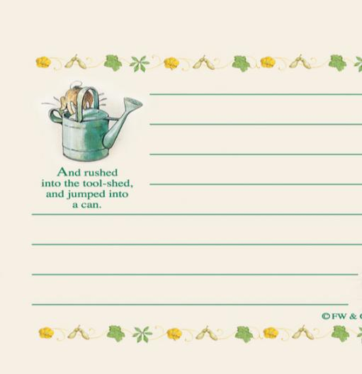
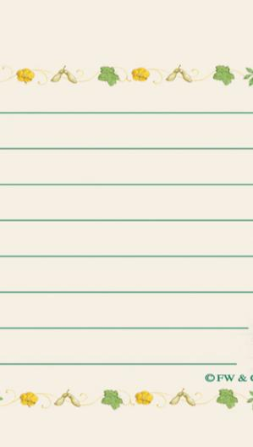


Homework
My dream job
I’m going to be…
where there is a will there is a way.

