Slide 1
Unit 2
My days of the week
兴宁市刁坊中心小学刘苑欣

Slide 2
Unit 2
My days of the week
Section B

Slide 3
Let's learn new
words

Slide 4
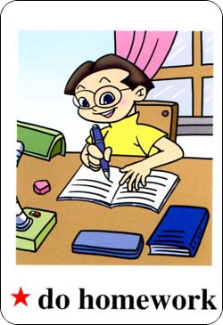
do homework
做家庭作业

Slide 5
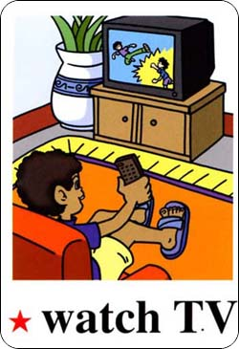
watch TV
看电视

Slide 6
read books
读书

Slide 7
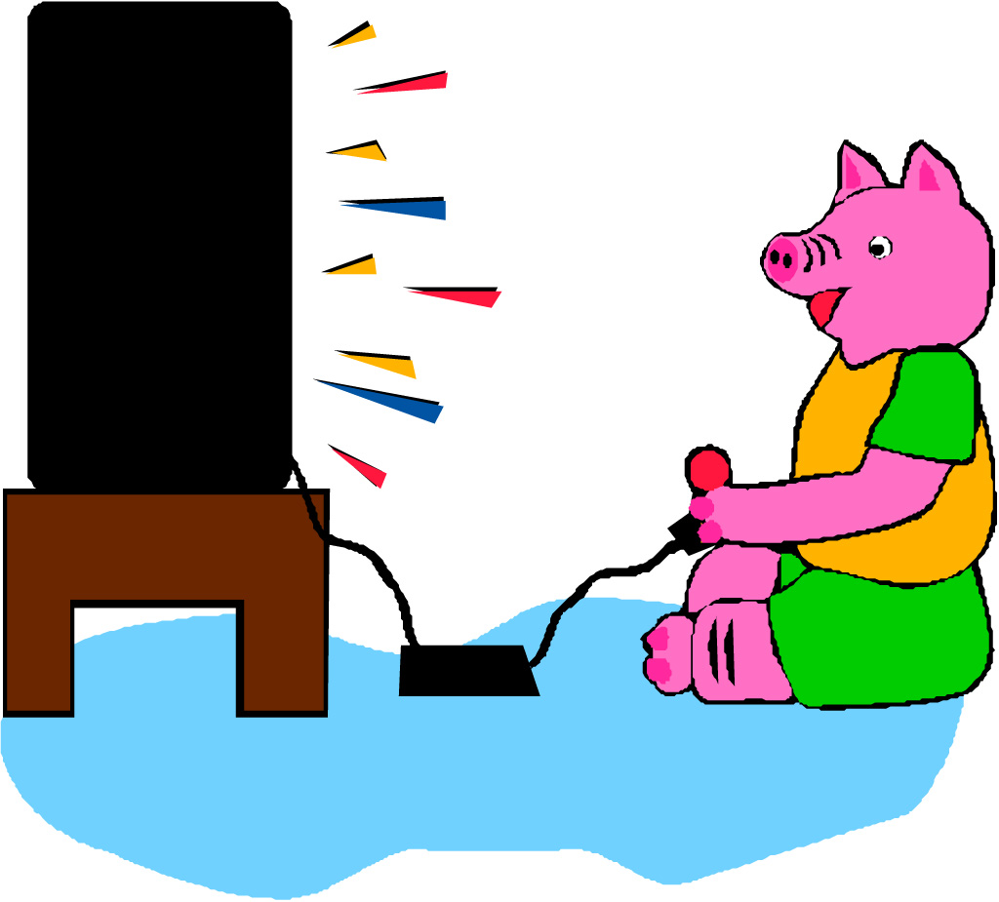
play computer games
玩电子游戏

Slide 8
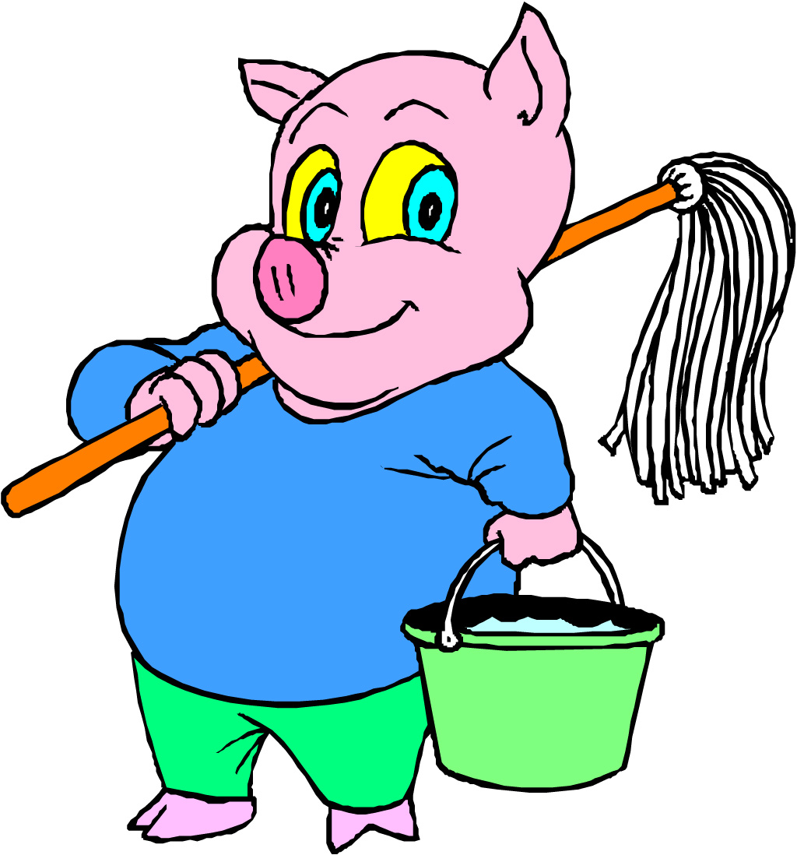
do housework
做家务

Slide 9
Let's practise!
do homework
watch TV
read books
play computer games
play ping-pong
do housework
You can choose

Slide 10
Monday
Tuesday
Wednesday
Thursday
Friday
Saturday
Sunday
You can choose

Slide 11
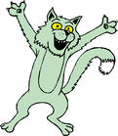
For example
What day is it today?
It’s Sunday.

Slide 12
I often read books and watch TV.
What do you do on Sundays?

Slide 13
What day is it today?
It’s __________

Slide 14
What do you do on________ ?
I often __________________

Slide 15
Let's chant!
Saturday, Saturday
What do you do on Saturdays?
I often paint or watch TV.
Saturday is fun for me!

Slide 16
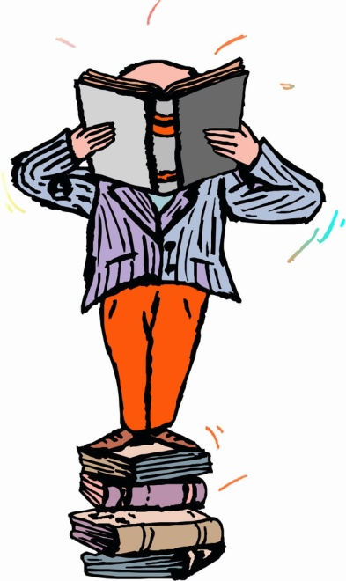
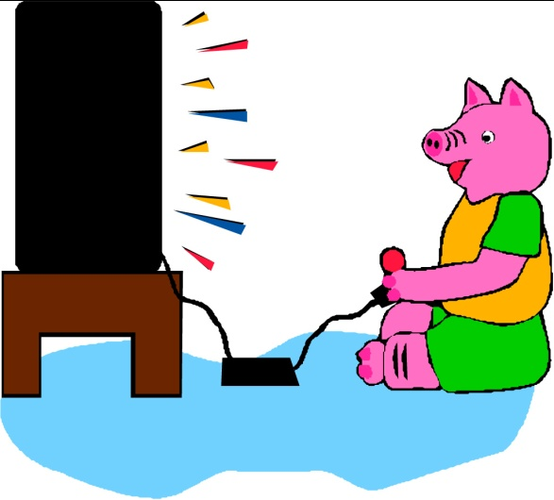
Sunday, Sunday
What do you do on Sundays?
I read books or play computer games.
Sunday is sweet for me!

Slide 17
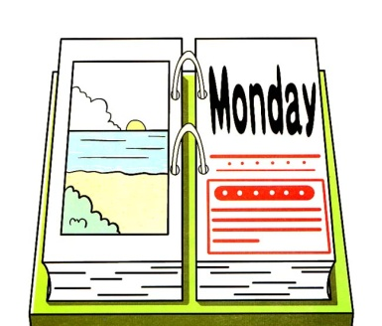
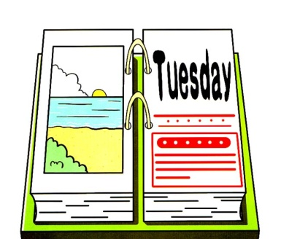
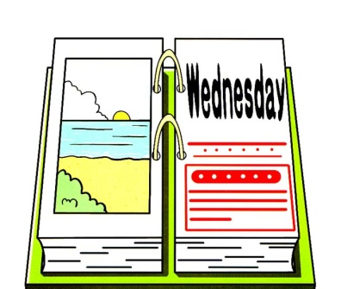
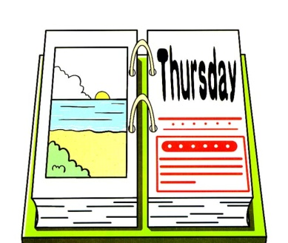
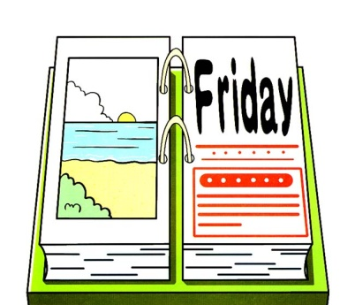
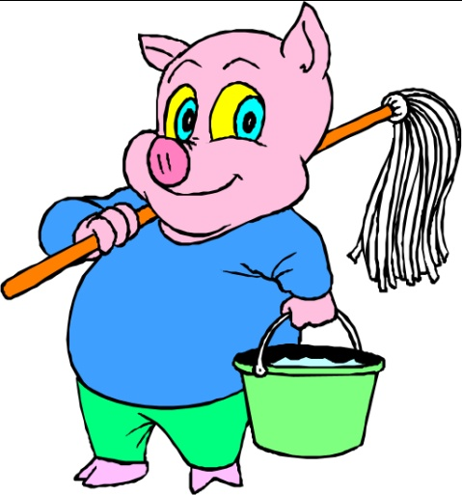
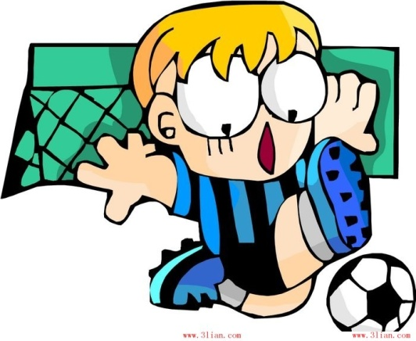
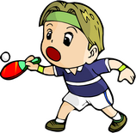
You can use

Slide 18
Homework
写一写你周
末的活动。

Slide 19
Thank you!

