Slide 1
Unit 3

Slide 2
Teaching Aims:
Identify ownership, master general question and (Yes or no ) short answers.
确认事物所有权，掌握一般疑问句 和用肯定或否定回答。
2. Master noun possessive pronouns.
掌握名词性物主代词

Slide 3
Find the stationery on your desk, when the teacher say the word, please show the object.

Slide 4
Is this your...? Yes , it is. It's mine.
No, it isn't. It's his/hers.
a pencil
a pen
a book
a schoolbag
a dictionary
an eraser

Slide 5
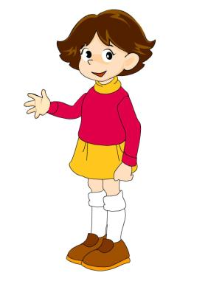
Is that your...?
Yes, it is. It's mine.
No, it isn't .
It's his/hers.
an eraser
a pencil box
a ruler

Slide 6
Are these/those your...?
Yes, they are. They're mine.
No, they aren't. They're his/hers.
pencils
schoolbags
pencil boxes
dictionaries

Slide 7
Unit 3
Is this your pencil?

Slide 8
Section A1
1a-2c

Slide 9
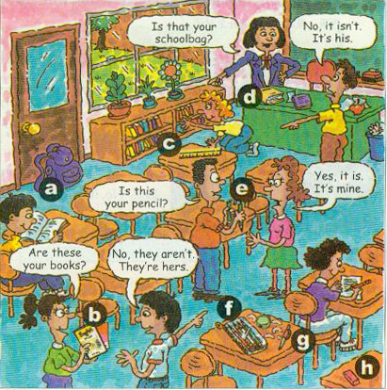
Match the words with the things in the picture.
1a
1. pencil __
2. pen __
3. books __
4. eraser __
5. ruler __
6. pencil box __
7. schoolbag __
8. dictionary __
e
g
b
h
c
f
a
d
Notes:
需换新书上的图片。

Slide 10
Listen and number the conversations [1-3].
1b
A: Is this your pencil?
B: Yes, it is. It’s mine.
3
A: Is that your schoolbag?
B: No, it isn’t. It’s his.
2
A: Are these your books?
B: No, they aren’t. They’re hers.
1

Slide 11
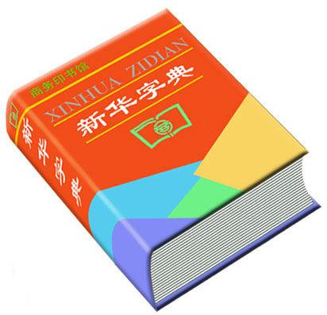
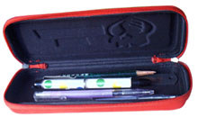
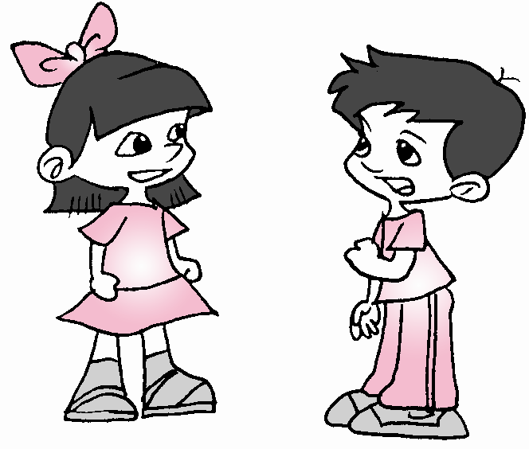
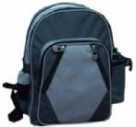
Pairwork
A: Is this/that your …?
B: Yes, it is. It’s mine.
No, it isn’t. It’s hers/his.
....

Slide 12
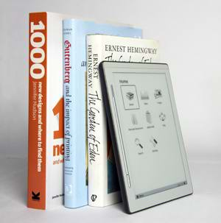
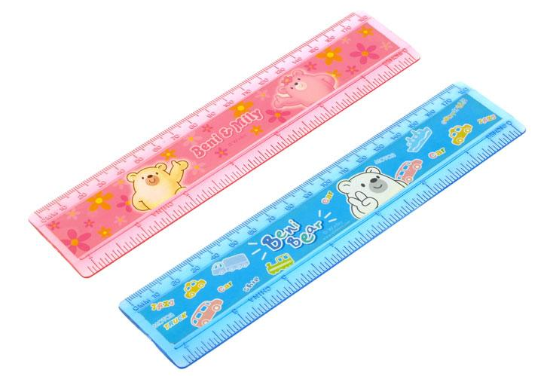
A: Are these/those your …?
B: Yes, they are. They’re mine.
No, they aren’t. They’re hers/his.
books
rulers

Slide 13
Is this your schoolbag?
Yes, it is. It's mine.
= It's my schoolbag
No, it isn't. It's his.
= It's his schoolbag
It's hers.
= It's her schoolbag.

Slide 14
形容词性物主代词与
名词性物主代词的比较
相同点：
他们的意思都一样，都指“…的”。
不同点：
形容词性物主代词后要接名词,如:my jacket; his pen; her ruler; 而名词性物主代词后面不接名词,如:mine; his; hers.

Slide 15
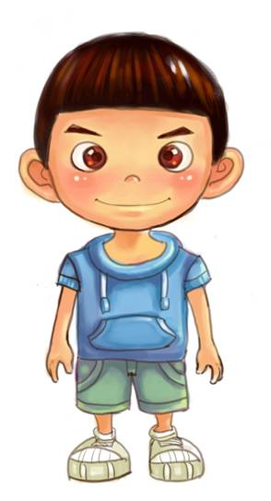
Exercise:
That’s my pencil.
It’s _____. (它是我的)
mine
That’s her key.
It’s _____. (它是她的)
hers
Those are his books.
They’re ___. (它们是他的)
his
my pen = mine
her key = hers
his books = his

Slide 16
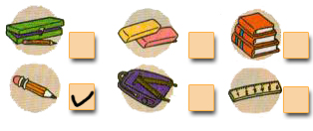
Listening
Listen and check (√) the things you hear.
2a
√
√
√
√
Notes:
需换新书上的图片。

Slide 17
2b
Listen again. Complete the conversation with the words in the box.
erasers pencil ruler pencil box books
Tom: Excuse me, Grace. Is this your pencil ?
Grace: Yes, thank you. And those are my _______.
Tom: And Jane, is this your ______?
Jane: No, it isn’t. It’s hers.
Tom: OK, and these are my ______. This is your _________, Jane.
erasers
ruler
books
pencil box

Slide 18
2c
Practice the conversation in 2b. Then make your own conversations using the things in your classroom.

Slide 19
Summary
1.确认所属关系:
当指的物品是单数时，用到的问句是：
___________________
Is this/that your ...?
肯定回答：_____________________
Yes, it is.
It's my ....
= It's mine.
否定回答：_____________________
No, it isn't. It's his/her....
= It's his/hers.
e.g. _______ your orange? 这是你的桔子吗？
Is this
Yes, it is.
________ 是的，它是。
________ her ruler? 那是她的尺子吗？
Is that
__________________ 不，它不是。它是我的.
No, it isn't. It's mine.

Slide 20
Summary
当指的物品是复数时，用到的问句是：
___________________
Are these/those your...?
肯定回答：__________________________
Yes, they are.
They're my ...
=They're mine.
否定回答：_____________________________
No, they aren't.
They're his/her...
=They're his/hers.
e.g. ___________ your pens?
这些是你的笔吗？
Are these
________________________ 是的，它们是我的。
Yes, they are. They're mine.
Are those his erasers?
________________________那些是他的橡皮吗？
No, they aren't. They're hers.
__________________________不，它们不是。是她的。

Slide 21
Summary
2.名词性物主代词: mine, his, hers.
my +n. =mine
his +n. =his
her +n.= hers

Slide 22
Excuse me, Grace. 打扰一下，格蕾丝。
Excuse me 意为“劳驾；请原谅”。常用于询问、求助或请求之前，表示歉意或礼貌。
Excuse me 与Sorry 的区别：
Excuse me 常用于事前请他人帮忙，或打扰别人 的情况；
Sorry 一般用于事后对犯错与或不能满足对方的请求等表示歉意。

