Slide 1
Unit5 Music Language points

Slide 2
第一段为背诵段
Paragraph1
Have you ever wanted to be part of a band as a famous singer or ______ (music)? Have you ever ________(梦想)playing in front of thousands of people at a concert, at which everyone is clapping and appreciating your music? Do you sing karaoke and ______（假装） you are a famous singer ____ Song Zuying or Liu Huan? ___________（说实话）, a lot of people ____________ ________________________________（把名和利看得很重）. But just how do people __________（组成乐队）.
musician
dreamed of
pretend
like
To be honest
attach great
importance to becoming rich and famous
form a band

Slide 3
1. … and pretend you are a famous singer like …?
pretend to do / be 假装做某事
pretend to be doing 假装正在做某事
pretend to have done 假装已做某事
pretend that-clause 假装+ that从句
The police are setting a trap for the drug-sellers. One pretends __________________________ (假扮成卖雪糕的) standing at the corner. One pretends __________________________________________ (假装刚刚购物完并正在等) the bus. One pretends _________________ (假装好像正在看) a newspaper.
(to be) an ice-cream seller
to have finished shopping and be waiting for
as if he were reading

Slide 4
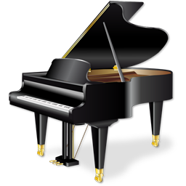
2. Have you ever dreamed of playing ...
A: 我有一个梦想。我总是梦想……。昨晚，我做了一个美梦，在梦中我……
dream of becoming
a super star
dream
I have a _____. I always ________________ ___________. Last night I______________ _____, in which _________________
dreamt a sweet dream
I stood on the stage with
many fans clapping and shouting below.
dream (dreamed,dreamed)v.&n. 梦想
dream of doing 梦想做某事

Slide 5
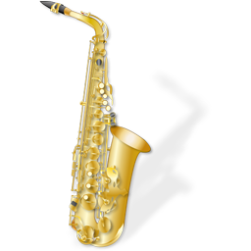
3. To be honest, ,many people attach great importance to ...
to be honest 说实话
be honest with sb. 对……老实说
be honest in sth. 坦白
翻译：说实话，我认为我们没有获胜的机会。
To be honest, I don’t think we have a chance of winning.
Policeman: You must be honest.
Criminal: Sir, believe me. I’m quite __________ you and I’m _________ what I do and say.
honest with
honest in

Slide 6
4. attach …… to doing sth.
①认为有（重要性、意义等）。
我认为这个研究很重要。
I attach great importance to this research.
类似表达还有：attach importance/ significance/ value/ weight/ etc. to (sth) 认为…有重要性（或意义、价值、分量等）
②附上；连接；
贴一张近照到你的申请表上。
Attach a recent photo to your application form.
③ 贴，粘贴
他将标签（label）贴在行李箱上。
He attached a label to his trunk.

Slide 7
Paragraph2
Sometimes they may play to ________ (passer-by) in the street or subway so that they can __________ _________ (赚额外的钱) for themselves or to pay for their instruments. Later they ______________（表演）in pubs or clubs, for which they are paid _______（现金）.
passers-by
earn some extra money
give performances
in cash

Slide 8
5. The musician were to play jokes on each other as well as play music, most of which was based loosely on the Beatles.
play a joke / trick on sb.
play jokes / tricks on sb. 戏弄
make fun of / laugh at sb. 嘲笑
Son: Susan cried today. She said we shouldn’t ____________________ (嘲笑她). But actually we _______________ (只是说说笑).
Father: Listen. No one likes _______________ (被嘲笑) or ___________________ (被戏弄), you know.
have made fun of her
were just joking
being laughed at
played jokes/tricks on

Slide 9
Paragraph4
As some of these actors could not sing well enough, they had to __________________ (依靠其他音乐家)to help them. … They were so popular ___ their fans formed clubs in order to ______ _______________(更熟悉他们). … The band _______ (解散) about 1970, ___ happily they reunited in the mid-1980s.
rely on other musicians
that
get more familiar with them
broke up
but

Slide 10
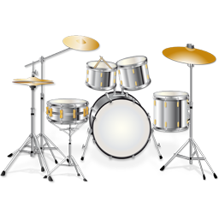
6. ... they had to rely on ...
rely on
depend on
count on
依赖、依靠
Translation：
说实话，我梦想着有一天不再依靠父母。
To be honest, I am dreaming of not relying on my parents one day.

Slide 11
7. ... in order to get more familiar with them...
be / get familiar with 对 ... 熟悉
be / get familiar to 为 ... 所熟悉
阅读句子,体会相关短语的意思。
I am familiar with the smell of the baking bread；that is to say, the smell of the baking bread is familiar to me.
总结：
表示主语“熟悉某人/某物，为______________________表示主语“为某人所熟悉”,为_______________________
be familiar with sb./sth.
be familiar to sb.

Slide 12
用“rely on” “be/get familiar with” “be/ get familiar to” 填空
Nowadays, we have to ______ our parents to live, but how much do you know about them? ____they _____ ___you? When are their birthdays? What are their favourites?...
Actually, we should ____________ _____them.
rely on
Are
familiar to
get more familiar with

Slide 13
8. The band broke up about 1970, but happily they reunited…
① 破裂, 拆散, 打碎
他们的友谊已经破裂了。
Their friendship has (been) broken up.
② 驱散
警察用武力驱散了人群。
The police broke up the crowd by violence.

Slide 14
break away（逃脱）
break down（坏掉）
break into pieces（破碎）
break out（爆发）
break up（分开）
break into（闯入）
break in（插话）
break up
The police tried to ______ ___ the crowd.
His house was _______ ____last night.
The Anti-Japanese War _______ ____ in 1937.
His car _______ _____ half-way.
Dad would occasionally _____ ____with a suggestion.
The prisoner _____ _____ from his guards.
He _____ the mirror ____ _____ and threw it into the dustbin.
broken into
broke out
broke down
break in
broke away
broke into pieces
Notes:
此页幻灯片选用

Slide 15
9.
above all: most important of all;
especially最重要的是，尤其
in all: altogether; as a total 一共；总计
after all: 毕竟；终究；别忘了
at all: (否定句)根本,完全
(疑问句)到底，究竟

Slide 16
短语搜索
1. 梦想做… _______________
2. 在音乐会上 _______________
3. 实话实说 _______________
4. 认为……很重要 _______________
5. 成名第一步 _______________
6. 赚额外的钱 _______________
7. 表演 _______________
8. 用现金 _______________
9. 录制唱片 _______________
dream of/about doing
at a concert
to be honest
attach importance to (doing) sth
the first step to fame
earn extra money
give performances
in cash
make records

Slide 17
10. in a different way _________________
11.play a joke/jokes on sb. _________________
12.be based on _________________
13.put an advertisement in a newspaper
__________________
14.rely on sb.(to do) _________________ 15.pretend to do sth __________________
16.be familiar with __________________
17.a year or so ________________
18.break up _________________
用不同的方式
开某人的玩笑
以……为基础
在报纸上做广告
依靠某人(做某事)
假装做某事
对……熟悉
大约一年（about a year）
解散

